Slide 1


Welcome you all
Transport Layer
D.Sakthivel
Assistant Professor & Trainer,
KG Micro College
KGiSL Campus, Coimbatore – 641 035.

Slide 2
Transport Layer

Slide 3
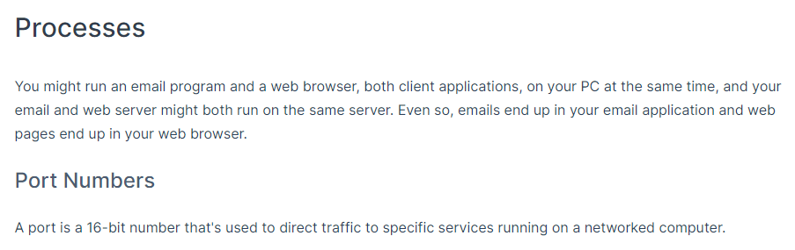
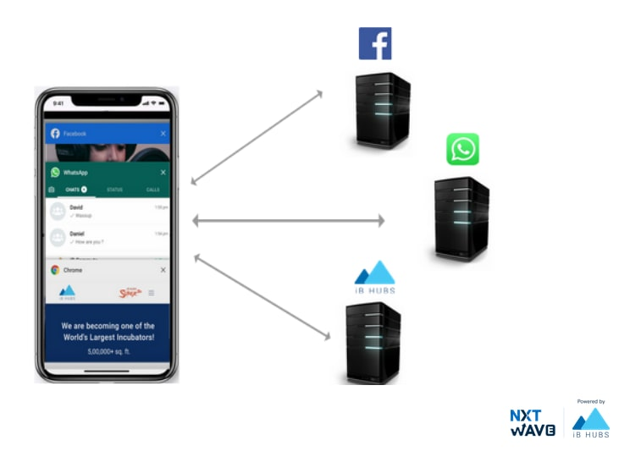

Slide 4
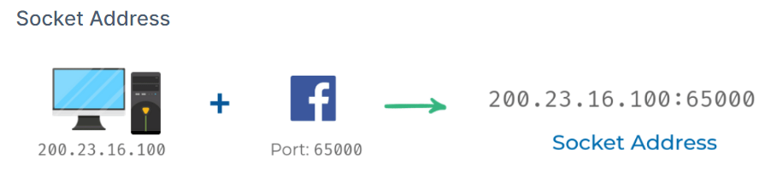
IP + Port = Socket Address

Slide 5
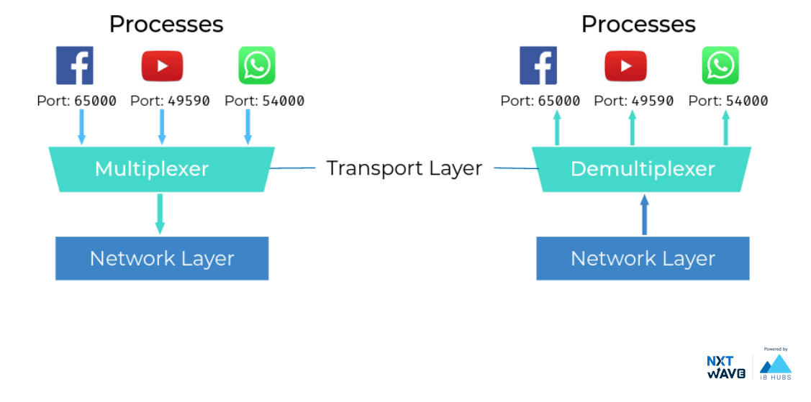
Multiplexing and Demultiplexing
Multiplexing in the transport layer means that nodes on the network have the ability to direct traffic toward many different receiving services.
Demultiplexing is the same concept, just at the receiving end, it's taking traffic that's all aimed at the same node and delivering it to the proper receiving service.

Slide 6
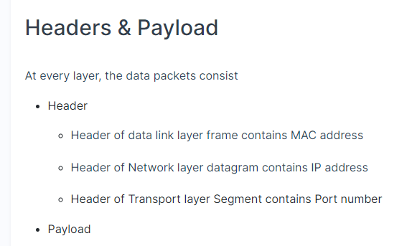

Slide 7
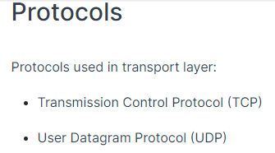

Slide 8
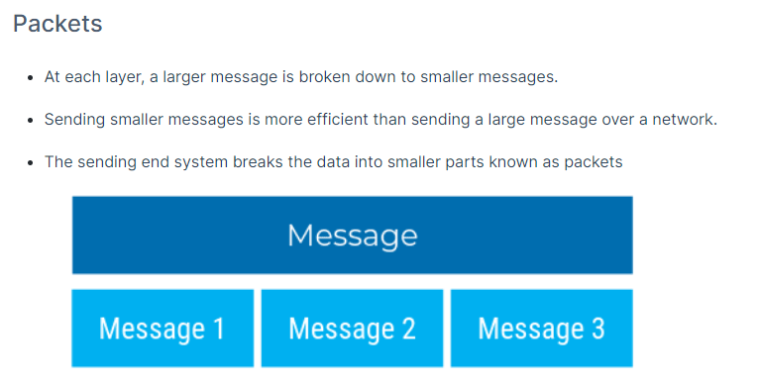

Slide 9
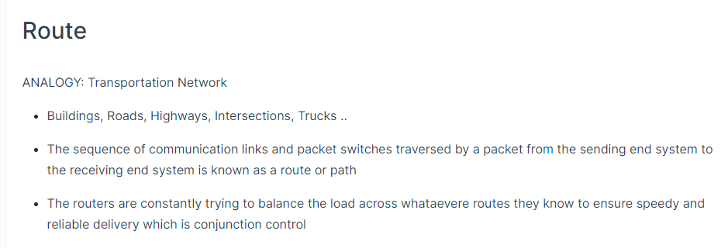
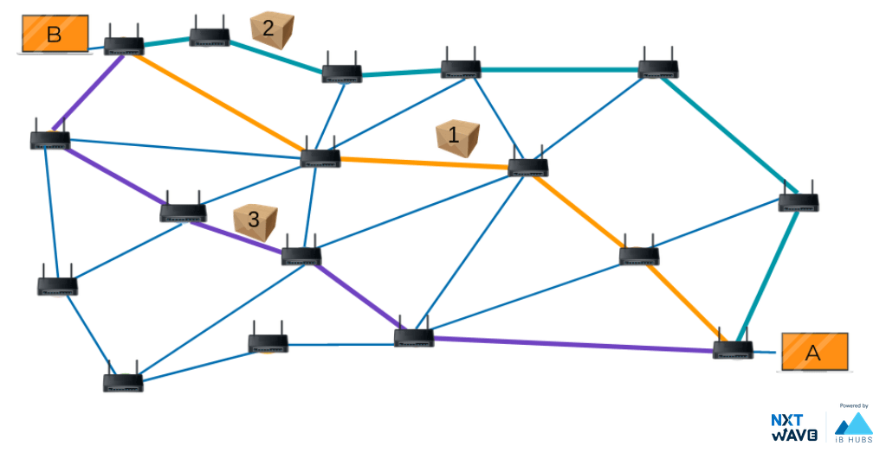

Slide 10
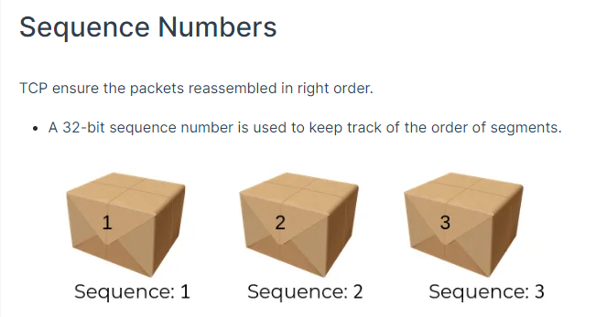

Slide 11
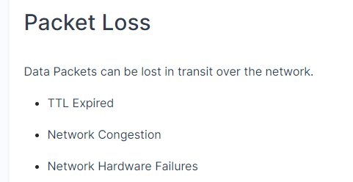

Slide 12
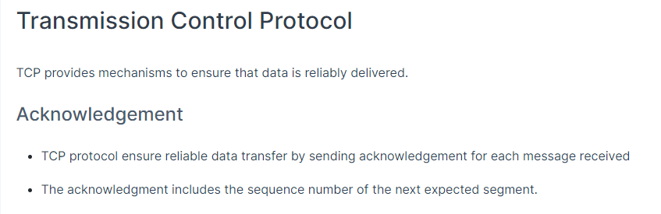

Slide 13
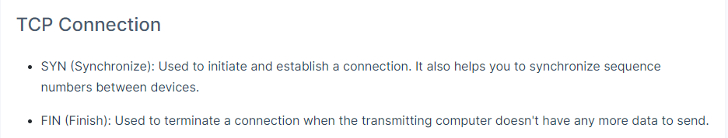

Slide 14
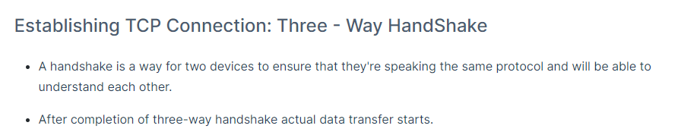
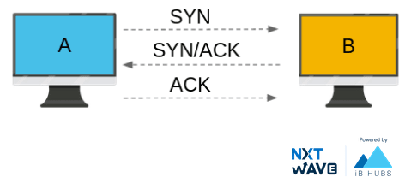

Slide 15
Data Transmission
Operation With No Loss
Once the three-way handshake is complete, the application data can begin to flow between the client and the server.
The client can send a data packet immediately after the ACK packet
When a packet of data is sent over TCP, the recipient must always acknowledge what they received.
The first computer sends a packet with data and a sequence number.
The second computer acknowledges it by setting the ACK bit and increasing the acknowledgement number by the length of the received data.
Those two numbers help the computers to keep track of which data was successfully received, which data was lost, and which data was accidentally sent twice.

Slide 16
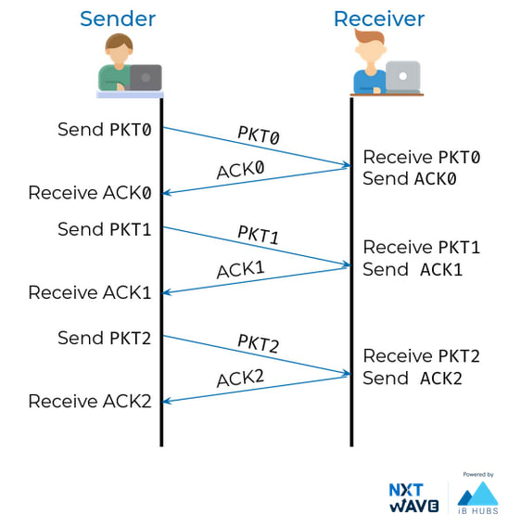
Data Transmission

Slide 17
Lost Packet
TCP connections can detect lost packets using a timeout.
After sending off a packet, the sender starts a timer and puts the packet in a retransmission queue.
If the timer runs out and the sender has not yet received an ACK from the recipient, it sends the packet again.

Slide 18
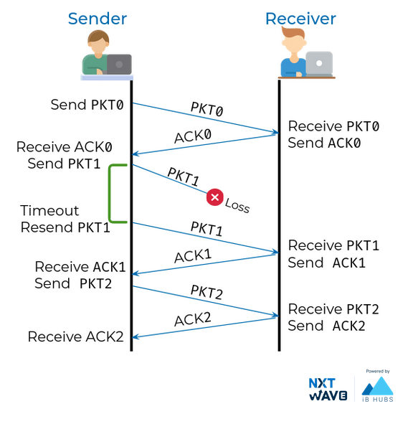
Lost Packet

Slide 19
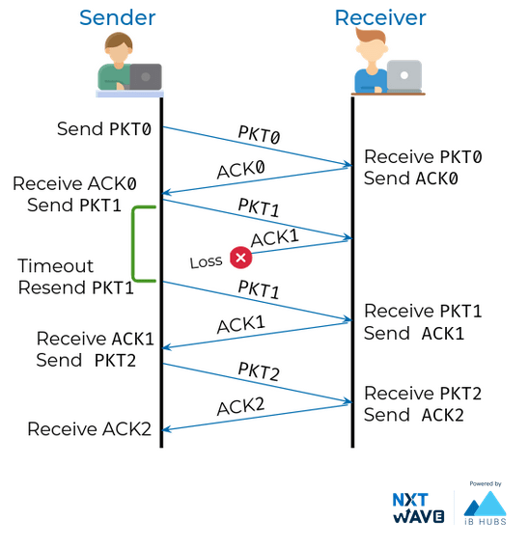
Lost ACK

Slide 20
Premature timeout
The retransmission may lead to the recipient receiving duplicate packets, if a packet was not actually lost but just very slow to arrive or be acknowledged.
If so, AS recipient has sequence it can simply discard duplicate packets.
It's better to have the data twice than not at all!

Slide 21
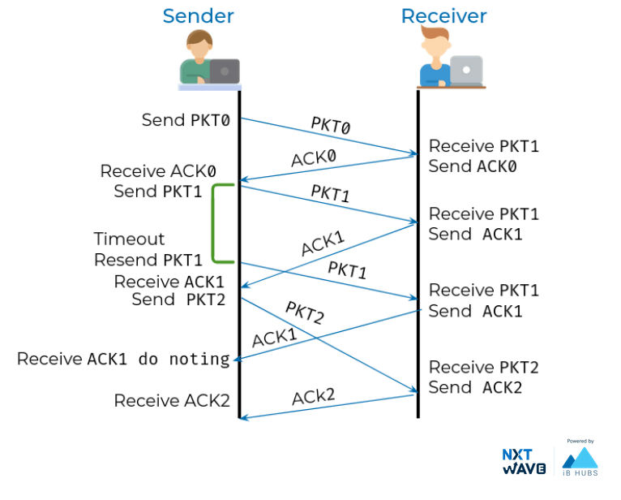
Premature timeout

Slide 22
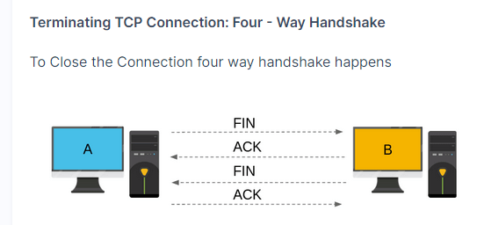

Slide 23
Internet traffic
TCP - Congestion Avoidance
Two phases in TCP Congestion Control Algorithms
Slow Start
Congestion Avoidance
Slow Start Phase: When connection begins increases rate exponentially(1, 2, 4, 8, 16…) until first packet loss. due to overload or congestion that packets may be dropped. Packets lost will trigger a timeout at the sender. When this happens, the sender goes into congestion avoidance phase
Example : first 1 packet is sent and got 1 ack , next doubles 2 packets is sent and after successful two acks it now send four packets the process goes on until the packet got lost.

Slide 24
Internet traffic
Congestion Avoidance Phase: In the Congestion Avoidance. It increase rate linearly. If congestion was indicated by a timeout, the congestion window is reset to one segment, which automatically puts the sender into Slow Start mode.
Example: the packet was lost at 4 segments in slow start so, in congestion avoidance phase it send again 4 segments after successful acks it increment by one and so the next it sends 5 segments . if the packet was lost. It reset with one segment it automatically puts the sender into Slow Start mode.

Slide 25
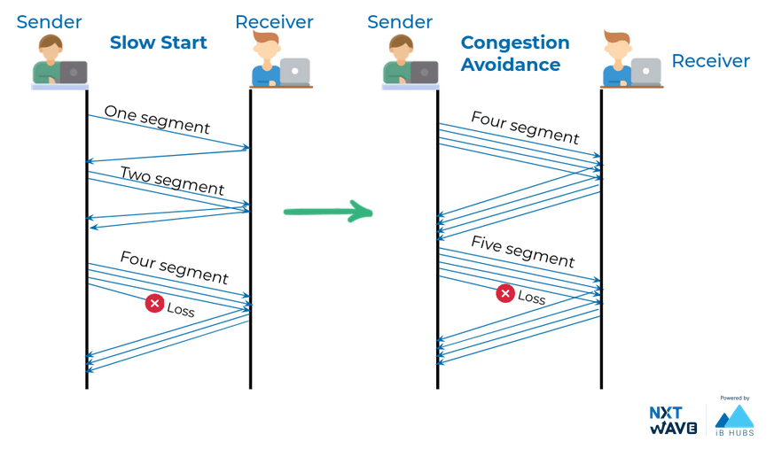
Internet traffic

Slide 26
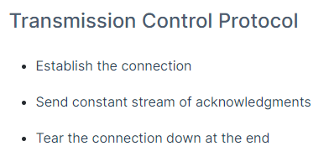
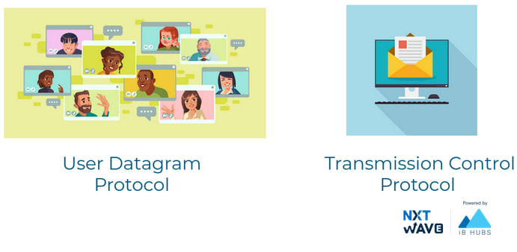
TCP vs UDP

Slide 27
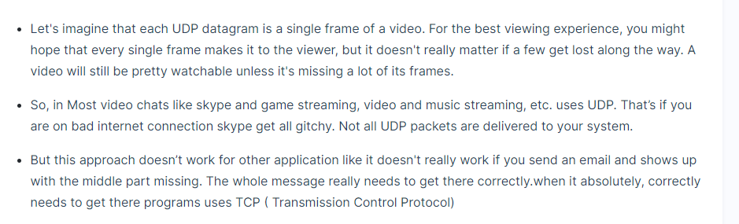

Slide 28
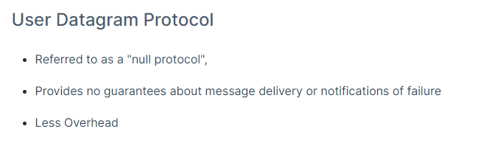

Slide 29
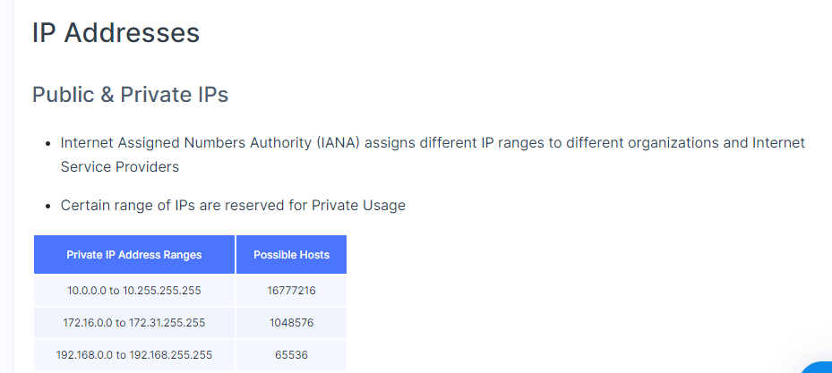

Slide 30
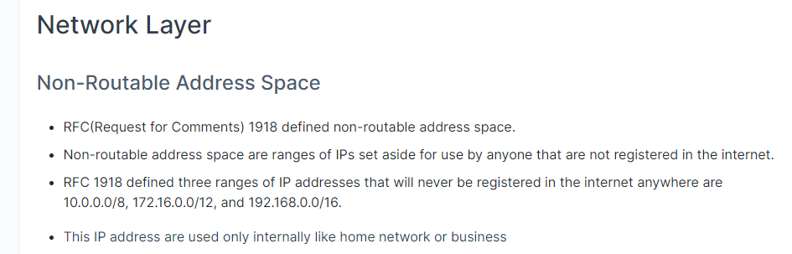

Slide 31
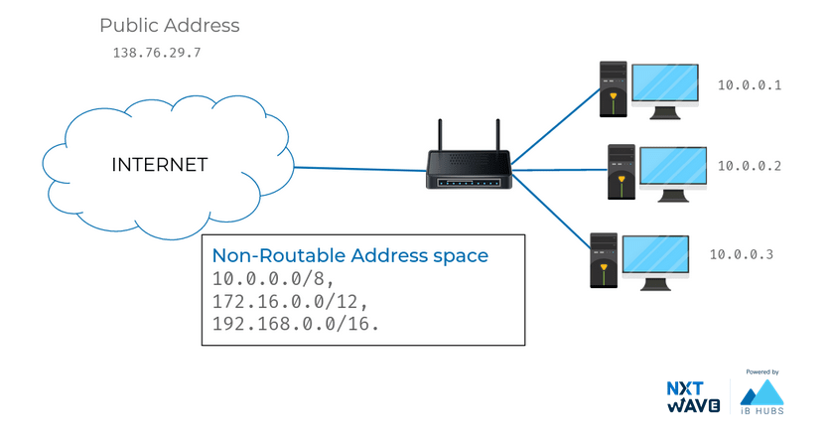

Slide 32
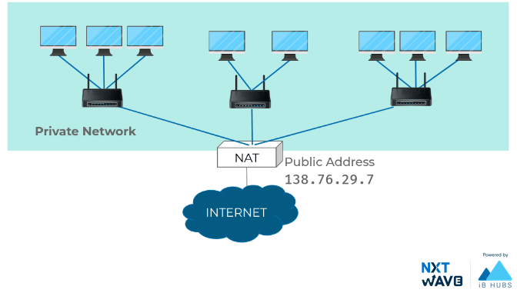
Network Address Translator
With NAT, you can have hundreds even thousands of machines using non-routable address space.
Yet, with just a single public IP, all those computers can still send traffic to and receive traffic from the internet.
All you need is one single IPv4 address and via NAT, a router with that IP can represent lots and lots of computers behind it.

Slide 33
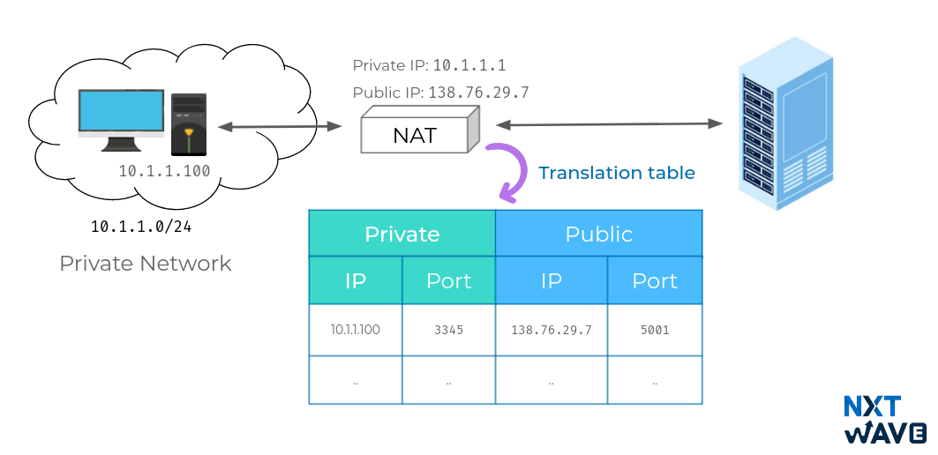
Network Address Translator
NAT is a technology that allows a gateway, usually a router, to rewrite the source IP of an outgoing IP datagram while retaining the original IP in order to rewrite it into the response.

Slide 34
Here, we have two networks. Network A consists of the 10.1.1.0/24 address space and network B consists of the 138.76.29.0/24 address space.
Sitting between these networks is a router that has an interface on network A with an IP of 10.1.1.1 and an interface on network B of 138.76.29.7.
Computer 1 is on network A and has an IP of 10.1.1.100.
And computer 2 is on network B and has an IP of 138.76.29.100.
Computer 1 wants to communicate with a web server on computer 2.
So it crafts the appropriate packet at all layers and sends this to its primary gateway, the router sitting between the two networks.
So far, this is a lot like many of our earlier examples, but in this instance,
Network Address Translator

Slide 35
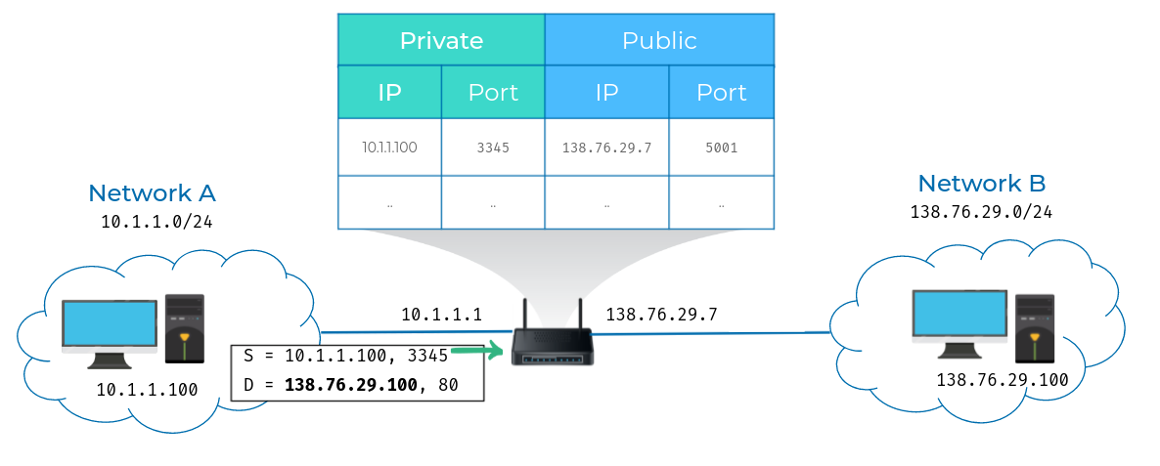
Network Address Translator

Slide 36
Network Address Translator
The router is configured to perform NAT for any outbound packets.
Normally, a router will inspect the contents of an IP datagram, decrement the TTL by 1, and forward the rest of the data at the network layer without touching it.
But with NAT, the router will also rewrite the source IP address, which in this instance, becomes the router's IP on network B or 138.76.29.7. When the datagram gets to computer 2, it'll look like it originated from the router, not from computer 1.

Slide 37
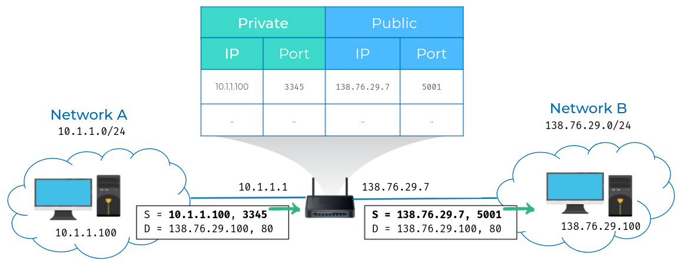
Network Address Translator

Slide 38
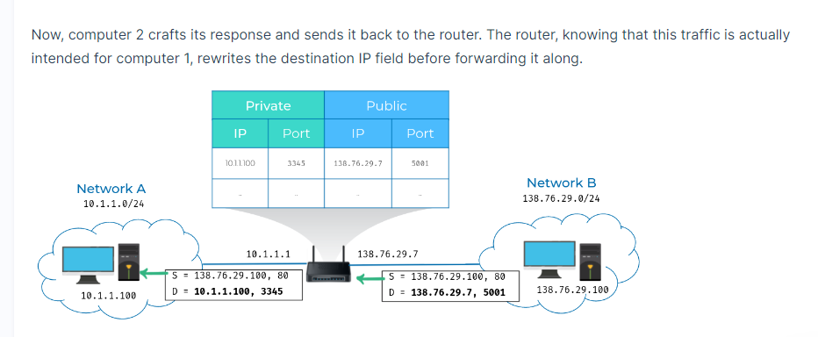
Network Address Translator

Slide 39



Thank You

